Slide 1




GUVI - Naan Mudhalvan
Engineering Hackathon 2025
www.guvi.in

Slide 2
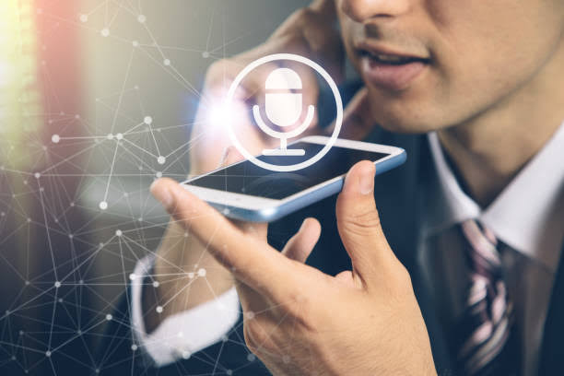
WELCOME
MULTILINGUAL SPEECH TO TEXT ENGINE FOR GLOBAL CALLCENTERS
Learning Programs
www.guvi.in

Slide 3
INTRODUCTION:
Global call centers handle customers in many languages.
High volume of calls requires efficient tools.
Manual transcription is time-consuming and error-prone.
Need for accurate, real-time, multilingual speech recognition.
Learning Programs
www.guvi.in

Slide 4
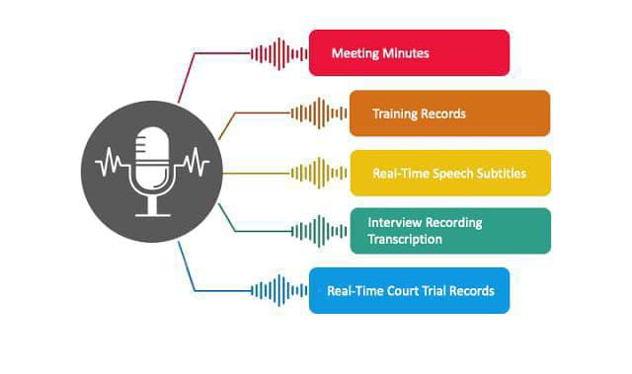
Learning Programsm
APPLICATION:
Meeting minutes
Training records
Real –time speech subtitles
Interview recording transcription
Real-time court trial records
www.guvi.in

Slide 5
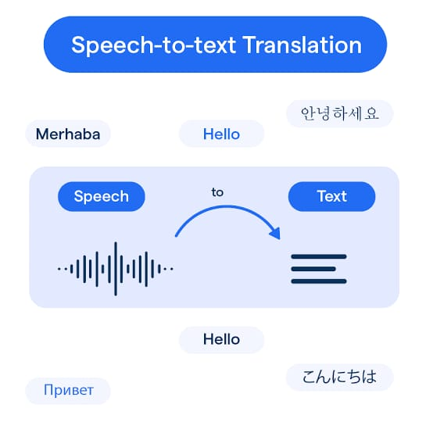
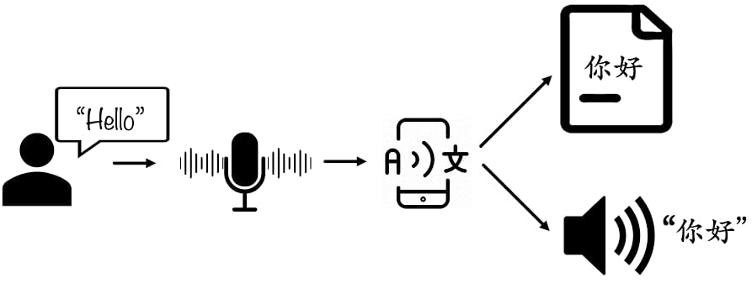
Examples :
Learning Programs
www.guvi.in

Slide 6
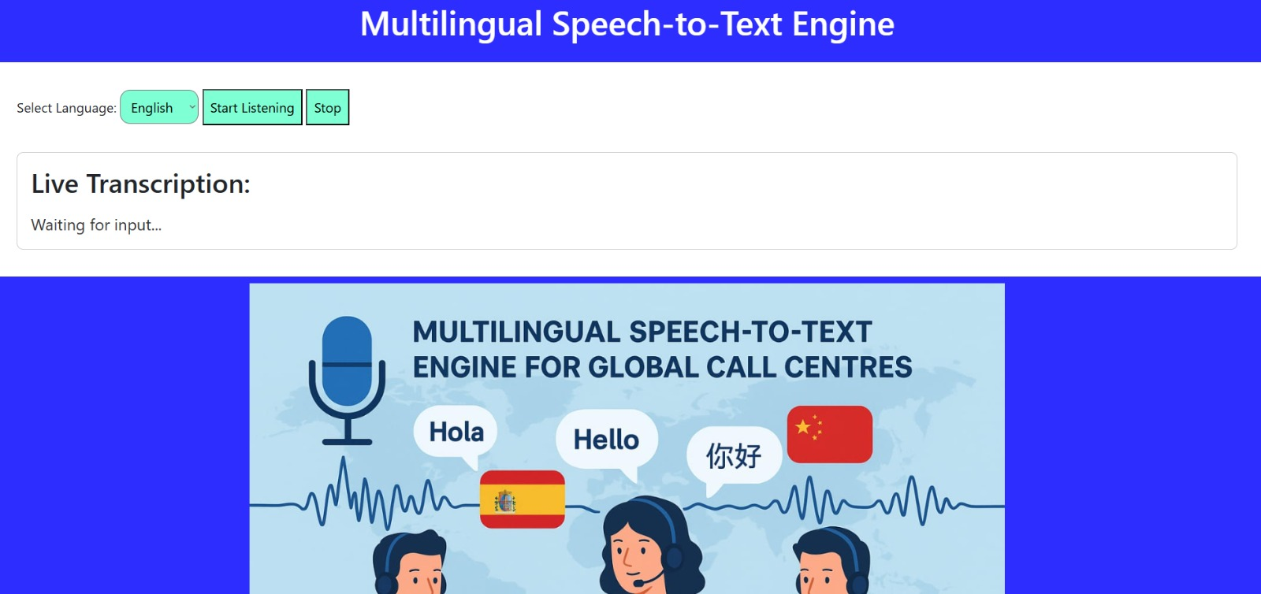
Project screenshots:
Learning Programs
www.guvi.in

Slide 7
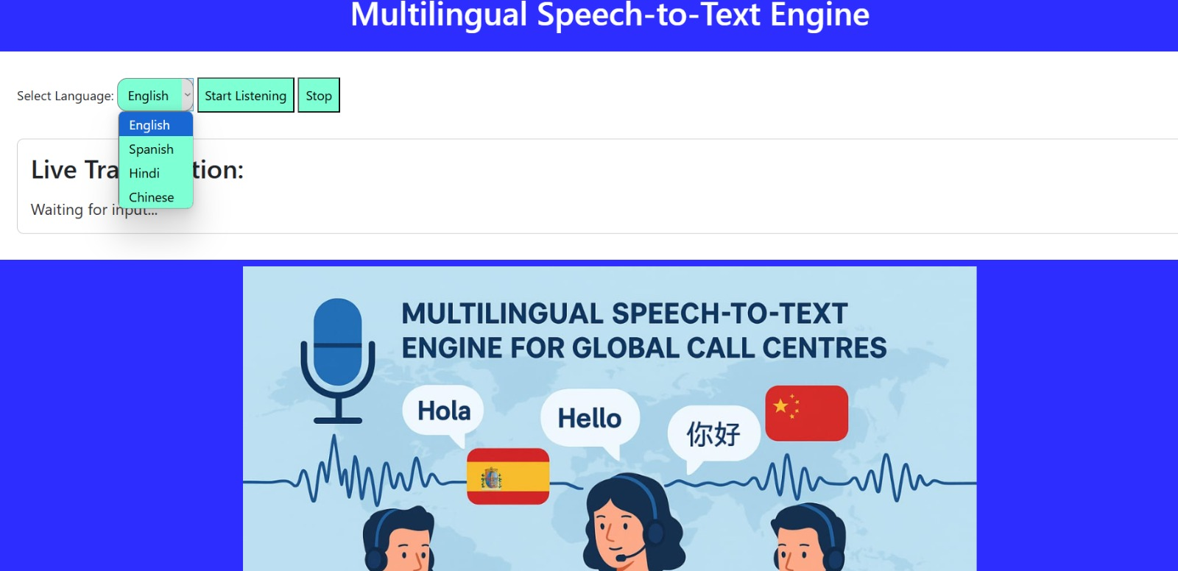
Learning Programs
www.guvi.in

Slide 8

BENIFITES:
Learning Programs
Improved customer experience(CX)
Real- time support & response
Scalable global operations
Cost efficiency
Global reach
Enhanced analytics
www.guvi.in

Slide 9
Advantage:
Learning Programs
Customer satisfaction
Global communication
Cost savings
Real-time assistance
Accurate transcriptions
Data insights
Scalability
Accessibility
Seamless integration
www.guvi.in

Slide 10
Thank you!!!
www.guvi.in

